Slide 1



Customer Segmentation via Multivariate Analysis
Extracting Business Profiles using PCA and K-Means
Presented By:
Oussama Ferchichi & Khaled Briki
Notes:
"Good morning. My name is Khaled Briki, and together with Oussema Ferchichi, we present our project: Customer Segmentation via Multivariate Analysis. The goal was to take raw wholesale customer data and extract real, actionable business profiles using two statistical methods — Principal Component Analysis (PCA) and K-Means Clustering. Let me walk you through exactly how we did that."

Slide 2


Project Objectives
Analyze multidimensional wholesale spending behavior.
Reduce data complexity using Principal Component Analysis (PCA).
Identify distinct, actionable customer profiles using K-Means Clustering.
Notes:
"Our project had three clear objectives.
First, we wanted to analyze multidimensional spending behavior — meaning we had 6 different spending categories per customer, and we needed to make sense of all of them together, not one at a time.
Second, we used PCA — Principal Component Analysis — to reduce that complexity. Six dimensions is impossible to visualize, so we compressed it down to two.
Third, once we could see the data in 2D, we applied K-Means Clustering to identify distinct customer profiles — groups that are different enough from each other to justify different business strategies."

Slide 3

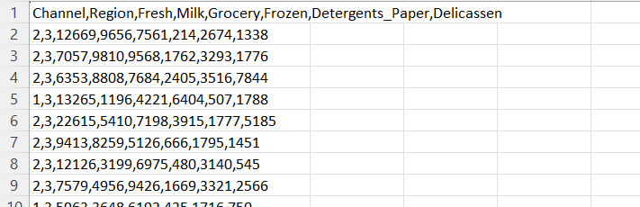
Dataset Overview
Source: UCI Machine Learning Repository
Size: 440 Customers × 8 Variables
Focus: Annual spending (m.u.) across 6 continuous categories: Fresh, Milk, Grocery, Frozen, Detergents, Delicatessen.
Notes:
"Our dataset comes from the UCI Machine Learning Repository — a well-known, trusted academic source. It contains 440 wholesale customers, each described by 8 variables. We focused on the 6 continuous spending variables: Fresh food, Milk, Grocery, Frozen goods, Detergents & Paper, and Delicatessen.
Each row in this table is one customer, and the numbers represent their annual spending in monetary units. As you can see, the values vary enormously — some customers spend a few hundred, others spend tens of thousands. That variation is exactly what makes this dataset interesting and challenging to analyze."

Slide 4

Data Preprocessing
Challenge: Financial spending is heavily right-skewed.
Step 1: Applied a Log(x+1) transformation to normalize extreme values.
Step 2: Applied Standard Scaling (Z-score) so large categories (like Fresh food) don't dominate the distance algorithms.
Notes:
"Before any analysis, we had to clean and prepare the data. There were two problems.
Problem one: the data is heavily right-skewed. Most customers are small buyers, but a handful of giant clients spend 50 times more than average. Those extreme values would distort our entire analysis if left untreated. So we applied a log(x+1) transformation, which compresses the extreme values proportionally without removing them.
Problem two: the 6 variables have very different scales. Fresh food spending reaches tens of thousands, while Detergents might be in the hundreds. Both PCA and K-Means calculate distances between data points — so a variable with bigger numbers would unfairly dominate the result. We fixed this with Z-score standardization, which converts every variable into 'how many standard deviations from the average is this customer?' Now every category is treated with equal weight."

Slide 5
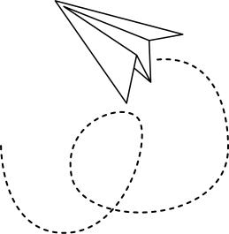
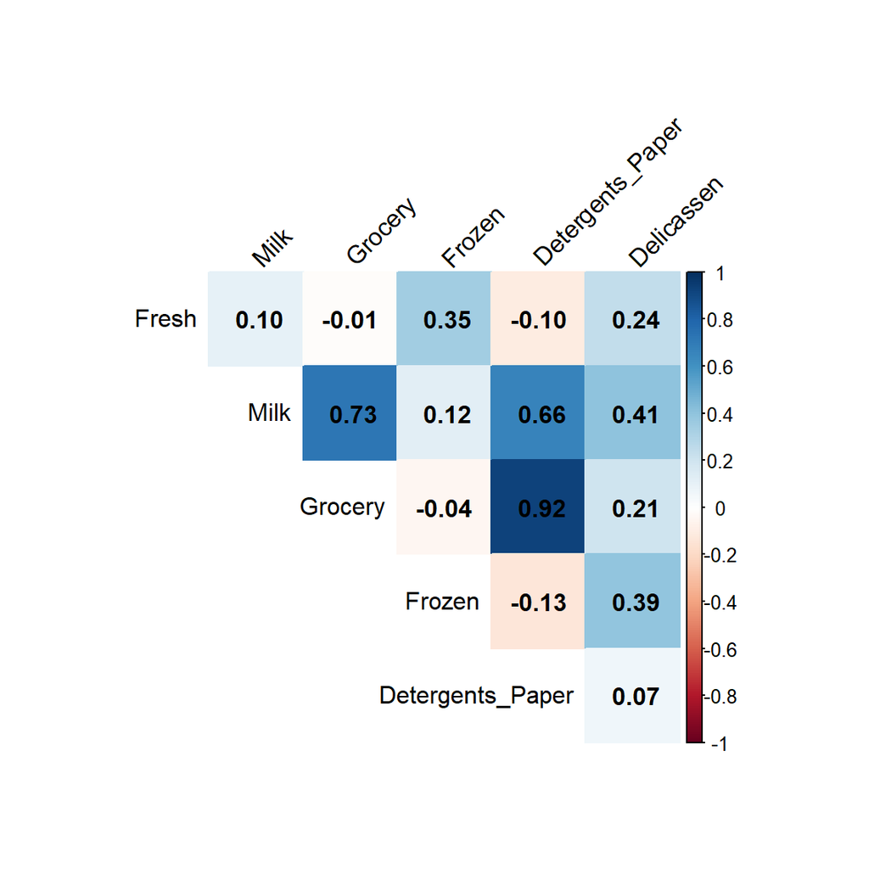
Exploratory Data Analysis (EDA)
Strong positive correlation:
Grocery + Detergents + Milk.
Independence: Fresh and Frozen operate independently of groceries.
Notes:
"Before running PCA, we explored the relationships between variables using a correlation matrix — this heatmap.
The key finding here is the dark blue square between Grocery and Detergents — a correlation of 0.92. That is extremely high. It means customers who buy a lot of Grocery almost always buy a lot of Detergents and Milk too. They move together.
On the other hand, Fresh and Frozen have very low correlations with Grocery and Detergents — close to zero or even slightly negative. They are independent — they represent a completely different type of buyer.
This is critical because it tells us, even before PCA, that there are two distinct behavioral axes in this dataset. PCA will confirm and formalize exactly that."

Slide 6
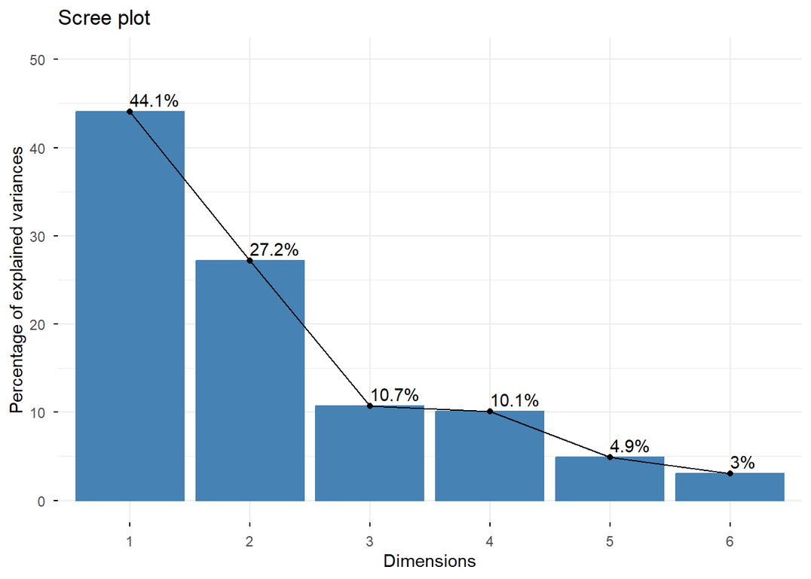
Principal Component Analysis (PCA)
Reduced 6 variables down to 2 dimensions.
71.3%
Total Variance Explained by First 2 Components.
Notes:
"Now, Principal Component Analysis. We had 6 variables — impossible to plot or cluster directly. PCA finds the combinations of those variables that explain the most difference between customers, and projects everyone onto those new axes.
Looking at this Scree plot, each bar represents one dimension. Dimension 1 alone explains 44.1% of the total variance in the data. Dimension 2 explains 27.2%. Together, the first two dimensions explain 71.3% of all the information in the dataset.
That means by going from 6 variables down to just 2, we kept 71% of the original information. We lost 29% — but what we gained is the ability to visualize and cluster 440 customers on a simple 2D map. That is a very strong and successful dimensionality reduction."

Slide 7
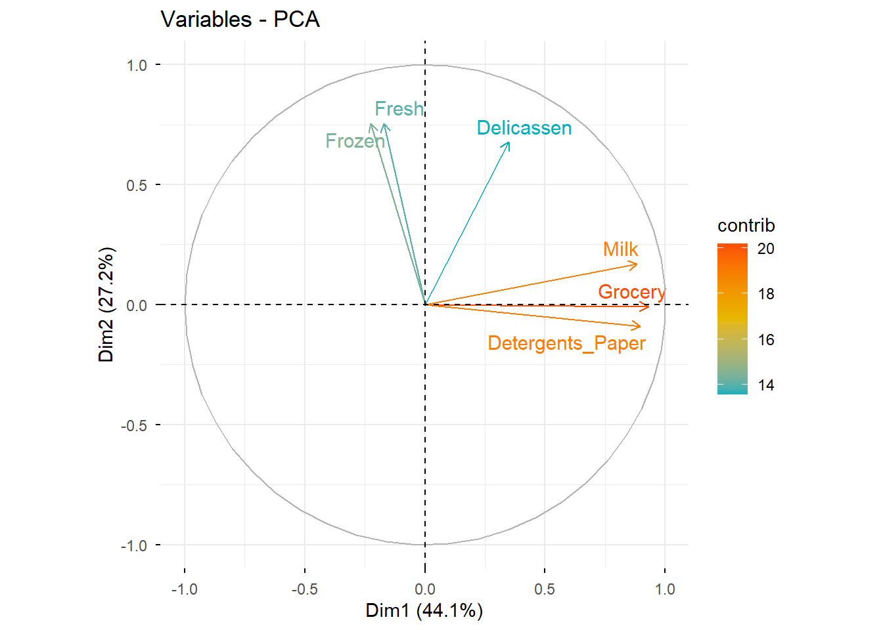
Interpreting the Dimensions
Dimension 1 (Horizontal): The "Retail Axis" (Grocery & Detergents).
Dimension 2 (Vertical): The "Restaurant Axis" (Fresh & Frozen).
Notes:
"This plot — called the Variables Factor Map or Circle of Correlations — tells us what each dimension actually represents.
Each arrow is one of our original 6 variables. The direction of the arrow shows which dimension it contributes to. The length shows how well that variable is captured in 2D — a longer arrow means it is well-represented.
Look at Dimension 1, the horizontal axis: Grocery, Milk, and Detergents all point strongly to the right. So Dimension 1 separates retail-oriented clients — the more a customer is positioned to the right, the more they look like a supermarket or grocery store. We call this the Retail Axis.
Now look at Dimension 2, the vertical axis: Fresh and Frozen point upward. So Dimension 2 separates customers who rely on perishable goods — restaurants, cafés, catering companies. We call this the Restaurant Axis.
This gives every customer a meaningful position on the map, not just a number."

Slide 8
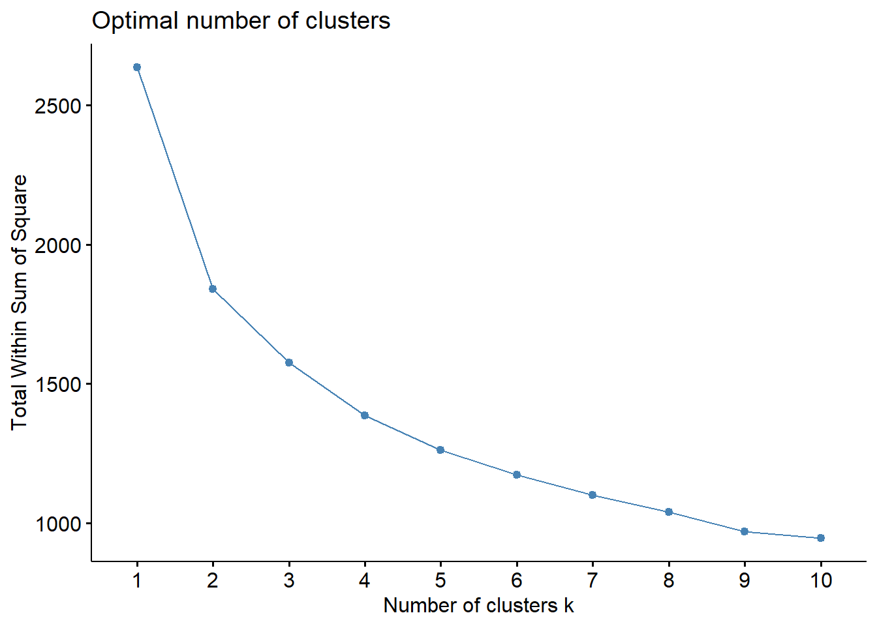
K-Means Clustering
Algorithm used: K-Means.
Optimization: Used the Elbow Method (Within-Cluster Sum of Squares).
Decision: K = 3 optimal distinct customer groups.
Notes:
"With our customers now on a 2D map, we applied K-Means Clustering to group them automatically.
The algorithm works like this: it places K random center points — called centroids — on the map. Every customer is assigned to the nearest centroid. Then each centroid moves to the geometric center of its assigned customers. This repeats until the assignments stop changing — that is called convergence.
But how do we choose K — the number of groups? We used the Elbow Method, shown in this plot. The Y-axis is WSS — Within-Cluster Sum of Squares — which measures how spread out customers are inside each group. Lower is better.
The curve drops sharply from K=1 to K=3, then it starts to flatten. That bend at K=3 is the elbow — the point where adding more clusters gives diminishing returns. Beyond 3, we would be splitting groups that don't need to be split. So K=3 is our optimal choice, mathematically justified."

Slide 9
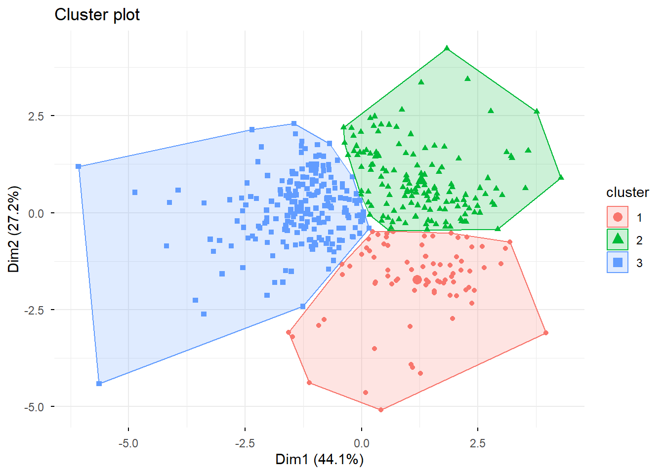
Integrating PCA
& Clustering
Projected the 3 K-Means clusters onto the 2D PCA space.
Result: Clean separation, proving highly distinct behavioral profiles.
Notes:
"This is where everything comes together. We took the 3 cluster labels produced by K-Means and projected them onto our PCA scatter plot — one color per cluster.
What we see are three clearly separated, non-overlapping zones. The blue group is on the left. The green group is on the upper right. The red group is on the lower right. Their boundaries do not heavily overlap.
This separation is the validation of our entire approach. It proves that the clusters are real and meaningful — not random or arbitrary. If the groups were blurry or overlapping, it would suggest the clustering failed. But here, the structure is clean and distinct, which confirms that these three behavioral profiles genuinely exist in the data."

Slide 10
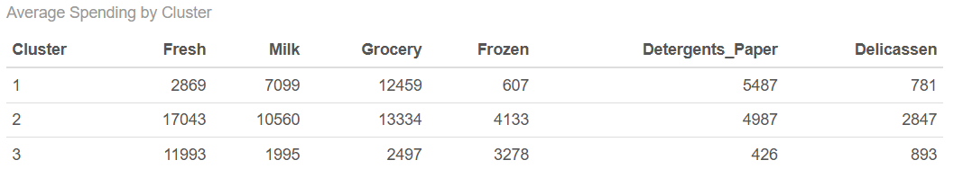
The Business Profiles
Cluster 1: Small/Medium Restaurants (High % of Fresh/Frozen)
Cluster 2: Large Retail Supermarkets (Massive Grocery/Detergents spend).
Cluster 3: Premium / High-Volume Fresh Buyers (Extremely high Fresh & Delicatessen).
Notes:
"Now we interpret what the three clusters actually mean in business terms, using the average spending table on this slide.
Cluster 1 — we call these the Retail Supermarkets. They spend very little on Fresh food — only 2,869 — but massively on Grocery at 12,459 and Detergents at 5,487. This spending pattern is typical of grocery stores and corner shops: they stock shelves with packaged goods, not kitchens with perishables.
Cluster 2 — these are the Premium High-Volume Buyers. They spend heavily across everything: 17,043 on Fresh, 13,334 on Grocery, 10,560 on Milk. These are large-scale operations — think hypermarkets like Carrefour, or large hotel chains. They are the highest-value clients in the dataset.
Cluster 3 — these are the Restaurants and Caterers. They spend heavily on Fresh at 11,993 and Frozen at 3,278, but almost nothing on Detergents — only 426 — and very little on packaged Grocery. That is the signature of a food-service business: they cook with ingredients, they don't stock retail shelves."

Slide 11

Strategic Recommendations
Restaurants: Offer dynamic daily deliveries for perishables.
Supermarkets: Negotiate long-term bulk contracts on non-perishables.
Premium Buyers: Upsell high-margin, farm-to-table specialty items.
Notes:
"Based on these three profiles, we propose three distinct business strategies.
For Cluster 3, the Restaurants: they depend on fresh, perishable ingredients every day. The recommendation is to offer dynamic daily delivery contracts — reliability and speed matter more than price for this group.
For Cluster 1, the Supermarkets: they buy non-perishables in large, predictable volumes. The recommendation is to negotiate long-term bulk contracts — they value price stability and supply consistency.
For Cluster 2, the Premium Buyers: they spend the most and buy across all categories. The recommendation is to upsell high-margin specialty items — farm-to-table products, premium brands — and assign dedicated account managers. These clients generate the most revenue and deserve the most attention."

Slide 12
Conclusion
In conclusion, we successfully took a complex, multidimensional dataset, applied strict statistical methodology, and produced three highly actionable customer segments.
Notes:
"To conclude: we started with a complex, 6-dimensional dataset of 440 wholesale customers. Through log transformation and standardization, we cleaned the data. Through PCA, we reduced it to 2 interpretable dimensions while keeping 71.3% of the information. Through K-Means with K=3, validated by the Elbow Method, we discovered three distinct and well-separated customer groups. And finally, we translated those mathematical groups into real business profiles with concrete, actionable recommendations.
This is not just a statistical exercise — it is a decision-support tool that a real wholesale company could use to serve their clients more intelligently."

Slide 13
Thank you for your attention

